Slide 1
Lecture 5
Exercise

Slide 2
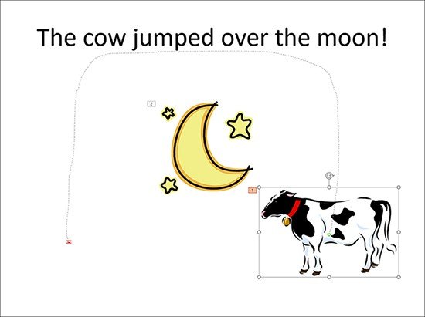
Using motion paths
Motion paths can emphasize objects in much the same way you use emphasis animation eﬀects such as the Spin and Underline eﬀects.
Motion paths can move an object in a circular, octagonal, or trapezoidal path.
A vertical ﬁgure-eight motion path even moves an object in a ﬁgure-eight pattern.
Motion paths do not necessarily have to move objects only in place on the slide. You can also use a custom motion path to relocate an object on a slide.
Select the object > Select a motion path in the Animation gallery (Lines, Arcs, or Loops) or select the More Motion Paths

Slide 3

